Slide 1

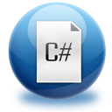




C# Programming Course – Part I
About the Course
Svetlin Nakov
Manager Technical Training
www.nakov.com
Telerik Software Academy
academy.telerik.com

Slide 2



Table of Contents
Course Objectives
Course Program
Trainers Team
Examination
Learning Resources
C# Programming

Slide 3
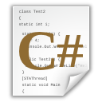


C# Programming: Objectives & Program
What Topics Shall We Cover?

Slide 4
C# Track Objectives
The C# Programming track at the Academy:
Give the trainees the fundamental computer programming knowledge and skills
Establish the logical and algorithmic thinking
Development of problems solving skills
Learn basic data structures, algorithms and object-oriented programming (OOP) concepts
Learn to produce high-quality code
Prepare for learning the software technologies
HTML5, DB & SQL, Cloud, ASP.NET, XAML, …

Slide 5
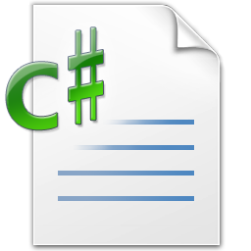
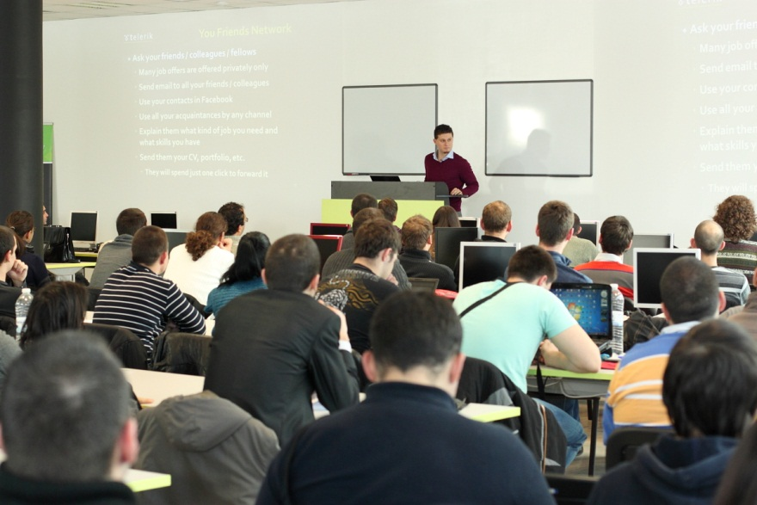
C# Part I – Course Topics
Introduction to Programming
Primitive Data Types and Variables
Operators, Expressions and Statements
Console Input / Output
Conditional Statements
Loops
Exam Preparation
C# Practical Exam

Slide 6
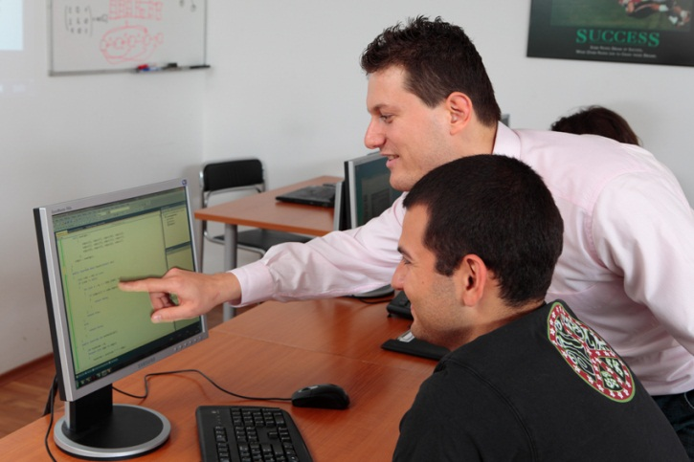
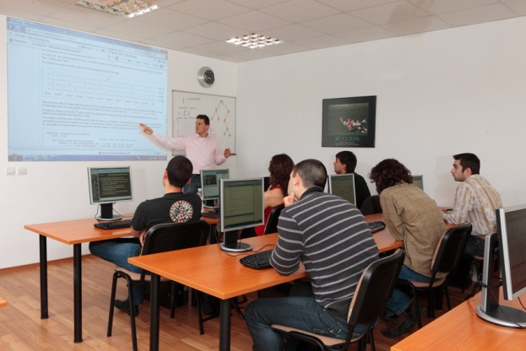
C# Part II – Course Topics
Arrays and Matrices
Numeral Systems
Methods
Creating and Using Objects
Strings and Text Processing
Problem Solving Methodology
Exam Preparation
C# Practical Exam

Slide 7


OOP – Course Topics
Object-Oriented Programming Basics
Defining Classes: Constructors, Visibility
Defining Classes: Fields, Properties, Methods
Exceptions Handling
OOP Principles: Abstraction, Encapsulation, Inheritance, Polymorphism
Interfaces, Abstract Classes, Templates, Indexers
Team Work: Creating OOP Game
Design Patterns
OOP Exam Preparation
OOP Practical Exam

Slide 8

High-Quality Code – Topics
Definition of High-Quality Code. Entrance Project
Naming the Identifiers. Code Formatting
High-Quality Classes. High-Quality Methods
Correct Usage of Variables, Constants, Conditional Statements and Loops
Defensive Programming and Exceptions
Code Documentation and Self-Documenting Code
Unit Testing and Test-Driven Development (TDD)
Code Refactoring. Refactoring Patterns
Practical Project & Defense

Slide 9
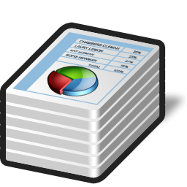
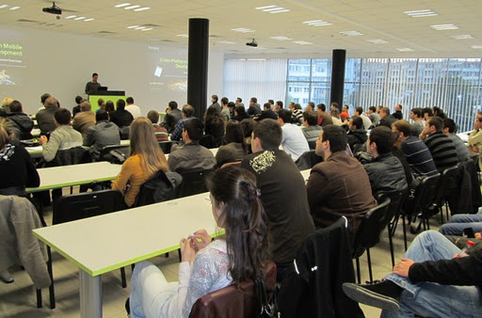
Data Structures & Algo – Topics
Linear Data Structures: Lists, Stacks, Queues
Trees and Graphs. Balanced Search Trees
Dictionaries, Hash-Tables and Sets
Complexity of Algorithms. Data Structures Efficiency
Sorting and Searching Algorithms
Dynamic Programming
Recursion and Combinatorics
Graph and Tree Algorithms
Problem Solving Methodology
Exam Preparation & Practical Exam

Slide 10
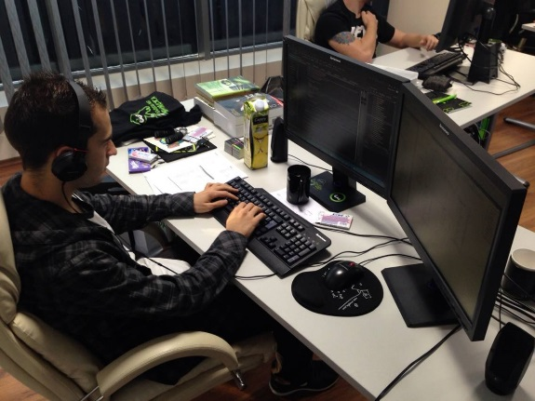
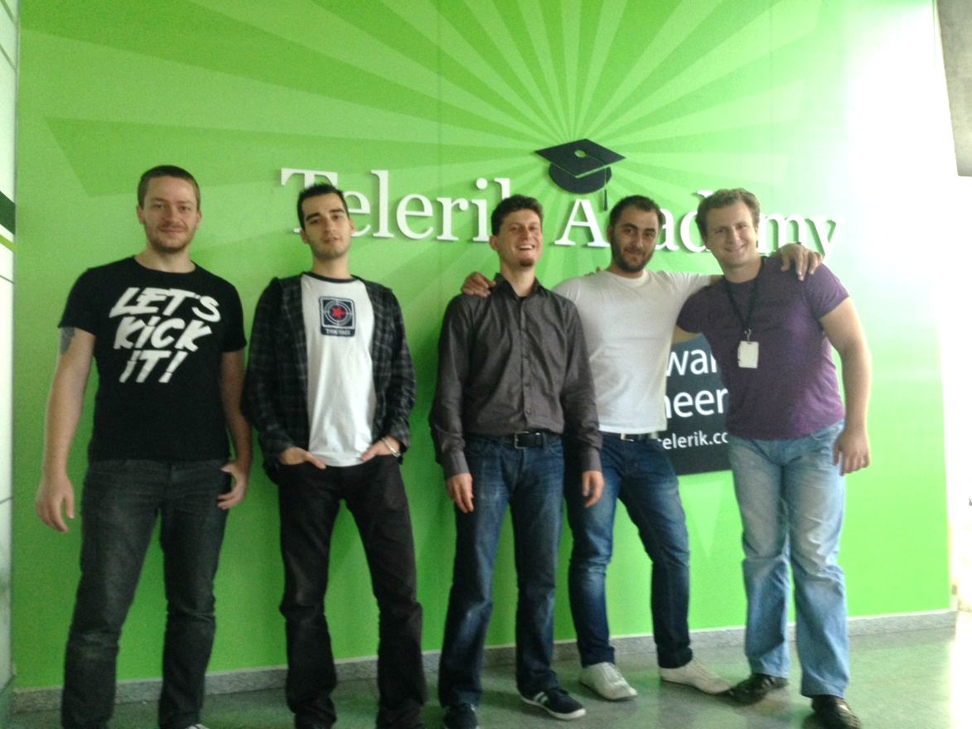
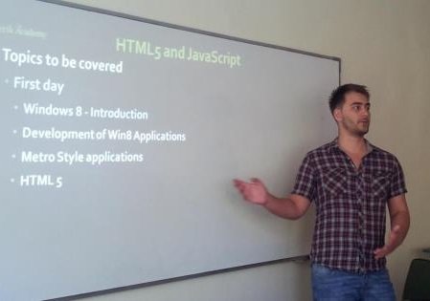
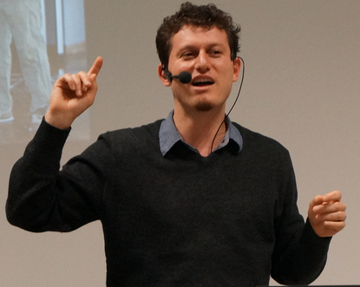
Trainers Team

Slide 11
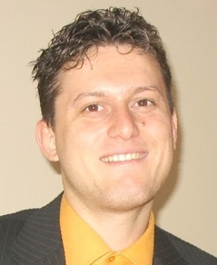
Trainers Team
Svetlin Nakov, PhD
Manager Technical Training @ Telerik Corp.
20 years software development experience
10+ years experience as trainer
Author of 6 books
Speaker at hundreds of events
E-mail: svetlin.nakov [at] telerik.com
Web site / Blog: http://nakov.com

Slide 12

Trainers Team (2)
Nikolay Kostov
Team Lead, Senior Developer and Trainer @ Telerik Corp.
Student in Sofia University
Computer Science
IT and Informatics competitions contestant
Champion from Telerik Software Academy
Email: nikolay.kostov [at] telerik.com
Blog: http://nikolay.it

Slide 13

Trainers Team (3)
Doncho Minkov
Senior Technical Trainer @ Telerik Corp.
Student in Sofia University
Software Engineering
Contestant in the Informatics competitions
Champion from Telerik Software Academy
Email: doncho.minkov [at] telerik.com
Blog: http://minkov.it

Slide 14
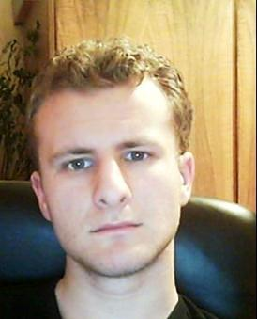
Trainers Team (4)
George Georgiev
Technical Trainer @ Telerik Corp.
Informatics and IT competitions contestant and winner
Student in Sofia University
Software engineering
Champion from Telerik Software Academy
E-mail: georgi.georgiev [at] telerik.com
Blog: http://itgeorge.net

Slide 15
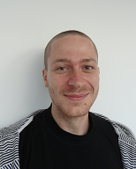
Trainers Team (5)
Ivaylo Kenov
Technical Trainer @ Telerik Corp.
Mathematical competitions contestant
Champion from Telerik Software Academy
E-mail: ivaylo.kenov [at] telerik.com
Champion in OOP and DSA

Slide 16
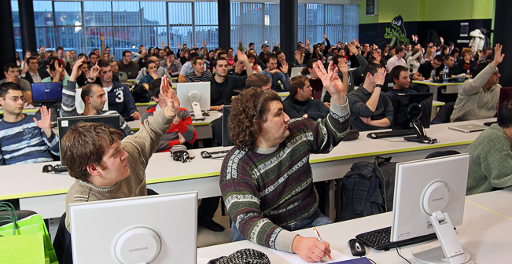
Volunteer Assistants
Assistants will aid you in your journey
Students from Telerik Academy (Spring 2013)
Top results in all programming exams

Slide 17
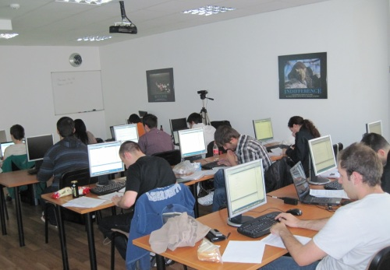

C# Programming Course – More Details
Duration, Languages, Technologies

Slide 18

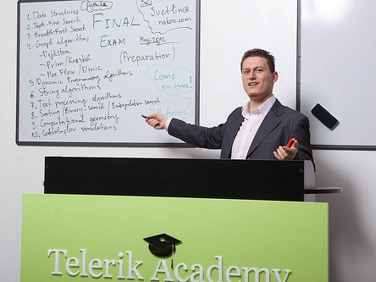
Training Duration – C# Part I
Lectures: ~ 15-20 hours (@ YouTube)
Practical exercises: ~ 24 hours
Homework: ~ 50-100 hours
Exam: 6 hours
Allocation
Timeframe
Late Oct 2013 – Early Dec 2013
Exam: Early Dec 2013

Slide 19

Why C# and .NET Framework?
Microsoft is very strong industry leader
.NET Framework and C# are the primary development technologies in the MS ecosystem
The C# language
Modern object-oriented language
Widespread and very popular
Easy to learn
Easy to switch to other languages

Slide 20


Why English?
Why the slides are in English?
English is the native language of the software engineers
Just learn it!
Specific terminology should be in English
Translations are inaccurate and funny

Slide 21
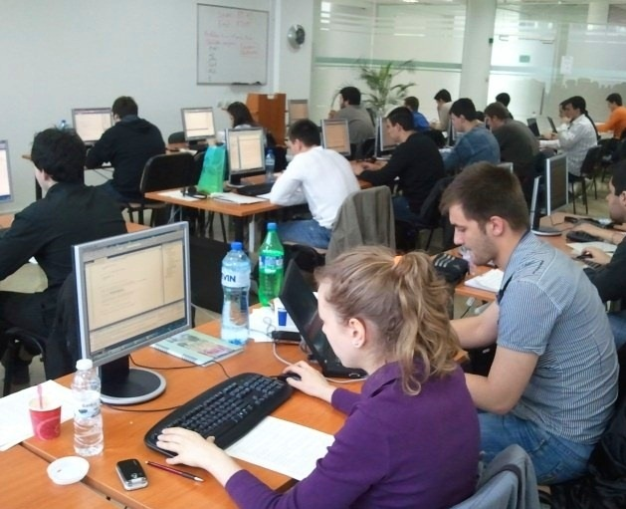
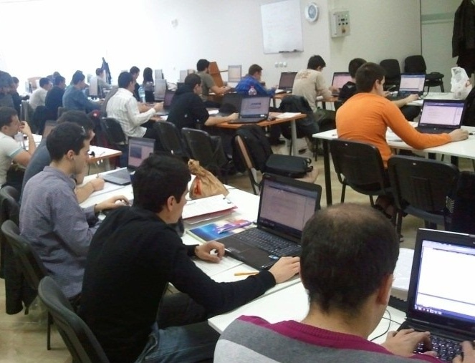
C# Part I Exams
Examination Criteria

Slide 22

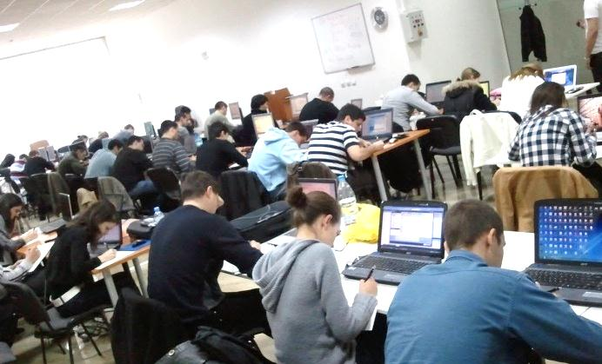
Exams @ Software Academy
Exams measure the individual performance
Serve as filter for the most skillful people
Score formed by many components:
Exam results, forums activity, homework, lectures attendance, etc.

Slide 23
Scoring System for C# Part I
Exam – 65%
Serves as primary pass / fail criteria
Team work – 10%
Attendance in class – 10%
Homework + evaluation – 10% + 5%
Forums activity – bonus up to 5%
Helping the other students – bonus up to 5%

Slide 24
C# Part I Exams
Practical Programming Exam
5 practical problems for 6 hours
Covers all learned topics up to the moment
Automated judge system & real-time feedback
Solutions are evaluated for correctness only

Slide 25
Homework Peer Reviews
Everyone will get feedback for their homework
Everyone will give feedback for few random homework submissions
Students submit homework anonymously
Please exclude your name from the submissions!
For each homework submitted
Students evaluate 3 random homeworks
From the same topic, after the deadline
Give written feedback, at least 200 characters
Low-quality feedback → report for punishment

Slide 26
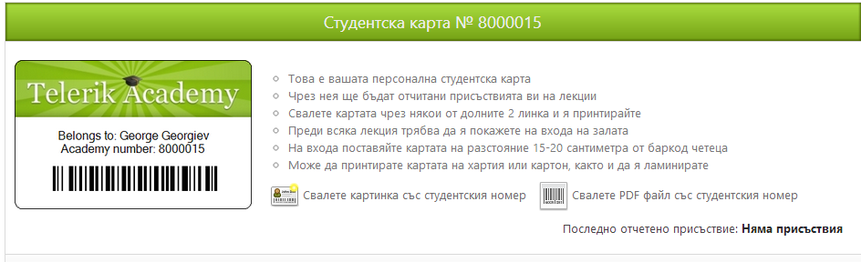
Attendance in Class
We encourage live participation
Top performers throughout the years have always spent lots of time in the academy halls
Register your presence @ barcode scanners
Last check-in is listed in your student profile
Scanners are next to the doors
Use Student ID Card
Check in +/- 30 min. before / after lecture starts

Slide 27


Pass / Excellence / Fail Criteria
Criteria for pass / pass with excellence / fail
Pass with excellence
Very high exam results
or
High total results
Pass
Average total results
Fail
Low total results or low exam results

Slide 28
C# Exam – Sample Problem
Write a program that enters a positive integer number N from the console and prints two symmetric triangles of size N separated by a vertical line, just like in the examples below:
N = 1
|
* | *
N = 2
|
* | *
** | **
N = 3
|
* | *
** | **
*** | ***
N = 5
|
* | *
** | **
*** | ***
**** | ****
***** | *****

Slide 29
The Judge System at the Exam
All exams will be tested automatically
Through our online judge system (BG Coder)
During the exam preparation you will practice how to use the automated judge system
You can register at any time to practice
How the testing (judge) system works?
You submit your C# source code
It tests your solution against predefined tests
For each test passed you get some score

Slide 30
Homework Assignments
Doing your homework is very important!
Programming can only be learned through a lot of practice!
After each lecture there are a few exercises
Try to solve them in class
The rest are your homework
Homework assignments due 2 weeks after each lecture – no excuses for being late
Deadlines are final & enforced by the system
Submit homework through telerikacademy.com

Slide 31








Resources
What We Need in Addition to this Course Content?

Slide 32
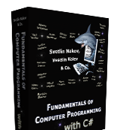
The C# Textbook
A very helpful resource for the course
“Fundamentals of Programming with C#”, Nakov S. and his team, 2013
Freely downloadable from: www.introprogramming.info
The C# track is based on the book
C# Part I → chapters 1..6 (up to Loops)

Slide 33
Course Web Site & Forums
Register for the "Telerik Academy Forums":
Discuss the course exercises with your colleagues
Find solutions for the exercises
Share source code / discuss ideas
The C# Part I official web site:
http://forums.academy.telerik.com/questions/csharp-programming/csharp-part-1
telerikacademy.com/Courses/Courses/Details/144

Slide 34

Telerik Integrated Learning System (TILS)
The Telerik Integrated Learning System (TILS)
www.telerikacademy.com
Important resource for all students
Homework submissions
Reports about your results
Presence cards (barcodes)
Calendar, team work
Etc.

Slide 35


Required Software
Software needed for this course:
Microsoft Windows (XP / Win7 / Win8)
Microsoft Visual Studio 2013 or Visual Studio Express 2013 (free version of VS 2013)
Visual Studio 2010, 2012 is also OK
.NET Framework 4.5 (included in Visual Studio)

Slide 36
C# Programming Course – Part I
http://academy.telerik.com

Slide 37


Free Trainings @ Telerik Academy
Fundamentals of C# Programming Track of Courses
csharpfundamentals.telerik.com
Telerik Software Academy
academy.telerik.com
Telerik Academy @ Facebook
facebook.com/TelerikAcademy
Telerik Software Academy Forums
forums.academy.telerik.com

